Slide 1
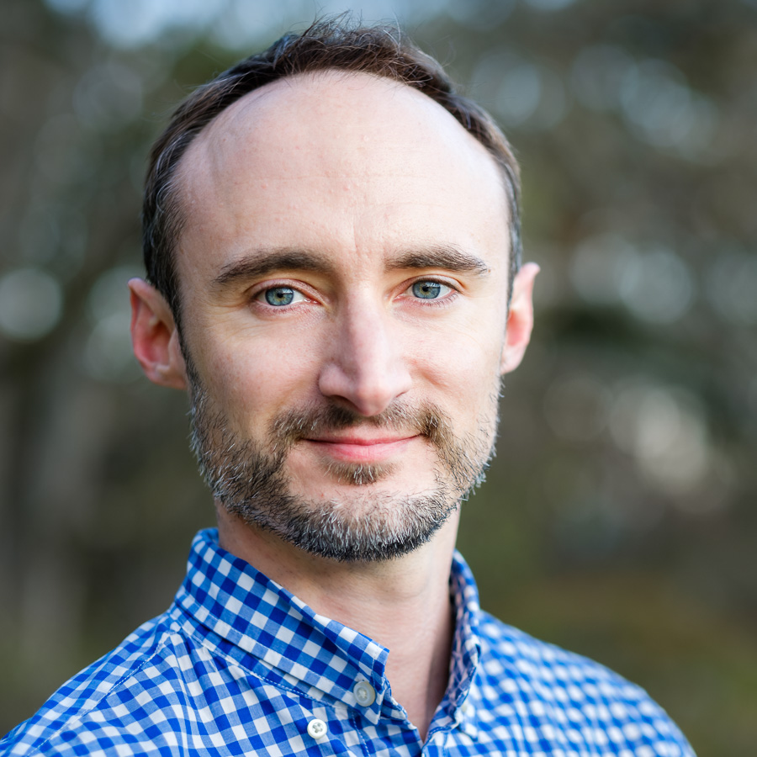
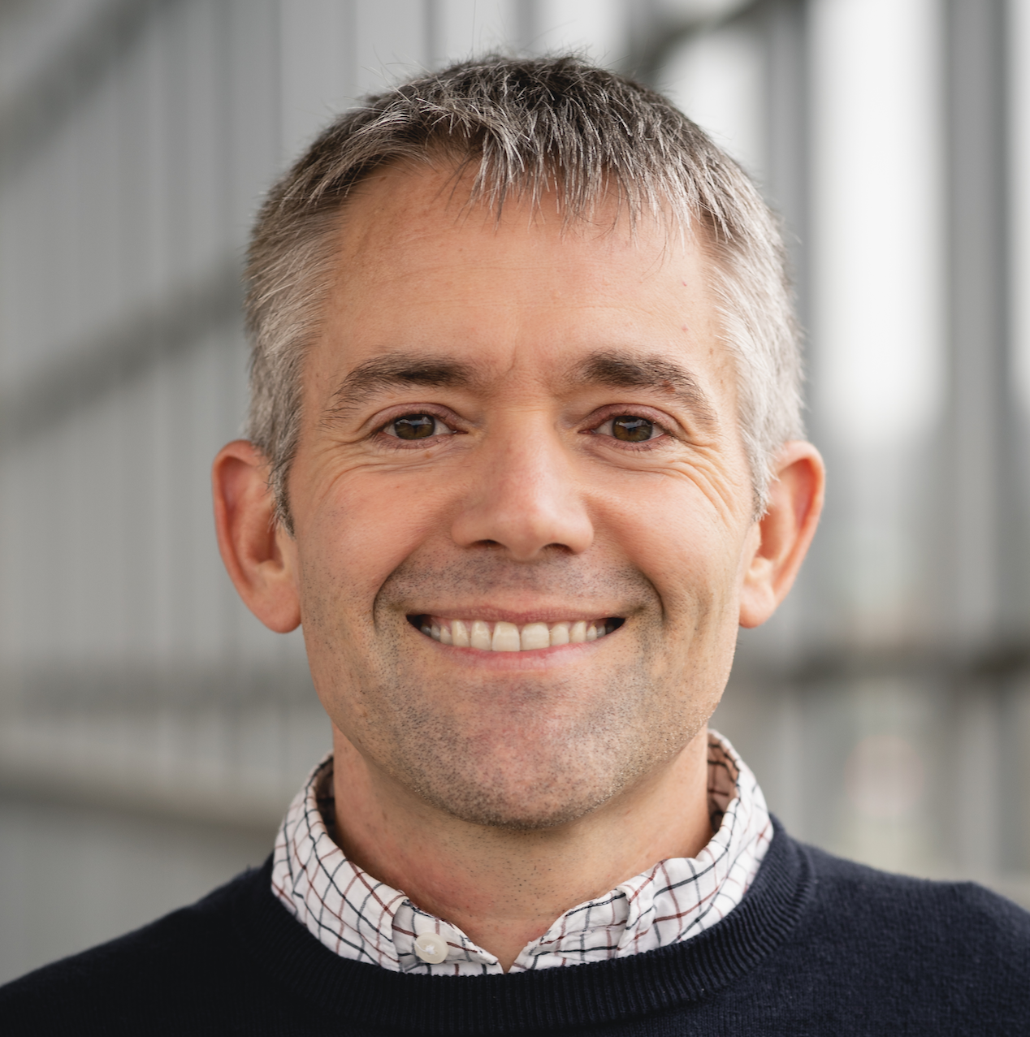
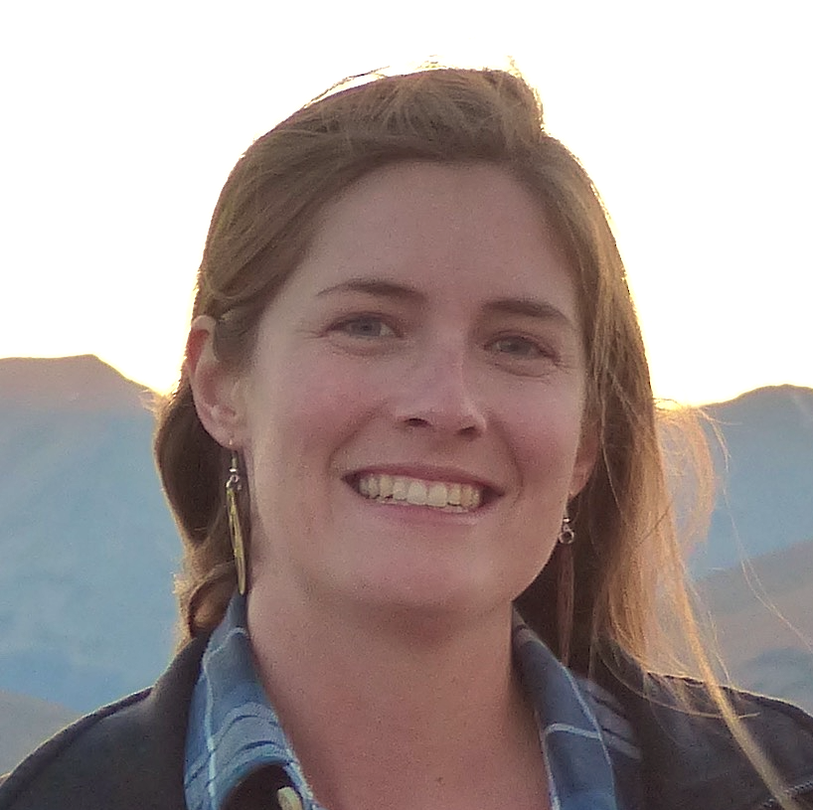
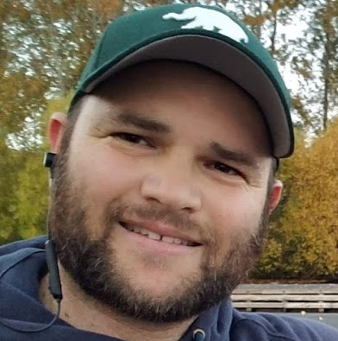
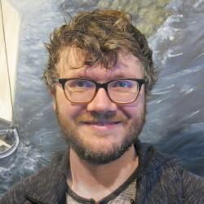
Sean Anderson
Pacific Biological Station (DFO)
Eric Ward
Northwest Fisheries Science Center (NOAA)
Philina English
Pacific Biological Station (DFO)
Lewis Barnett
Alaska Fisheries Science Center (NOAA)
Jim Thorson
Alaska Fisheries Science Center (NOAA)

